Slide 1
Cloud computing
Binod Adhikari

Slide 2
Binod Adhikari
Bachelor of engineering, Electronics and communication, IOE, WRC, Pokhara
Masters of science, Information and communication engineering, IOE, Pulchowk Campus, Kathmandu
Email: binod.adhikari1@bostoncollege.edu.np

Slide 3
outline
We will learn
Theoretical and practical aspects of cloud computing
Overall picture of cloud computing
Major components of cloud computing
Evolutions and recent trends
Different types of architectures, standards
Securities and other aspects
Course (CMP 475) overview

Slide 4
CMP475: Cloud computing course overview
1. Introduction of cloud computing (10 hr)
Overview of cloud computing.
Major components
Deployment models
Business use
2. Service models (11 hr)
Xaas: different service models
Elastic cloud
3. Cloud computing technology (13 hr)
Hardware and infrastructures
Standards
Storages
Architectures
Data center vs cloud data center
4. Security (11 hr)
How secure cloud computing is
Different security aspect and there mitigations

Slide 5
What is cloud computing?
Cloud itself is a set of hardware, networks, storage, services, and interfaces that enable the delivery of computing as a service.
Cloud services include the delivery of software, infrastructure, and storage over the Internet (either as separate components or a complete platform) based on user demand.

Slide 6
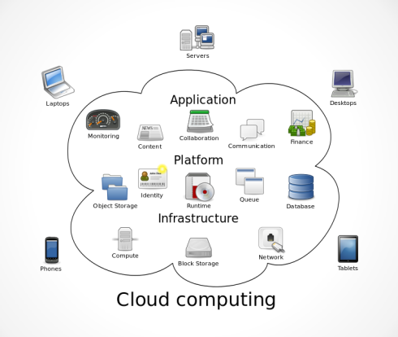
What is cloud computing?

Slide 7
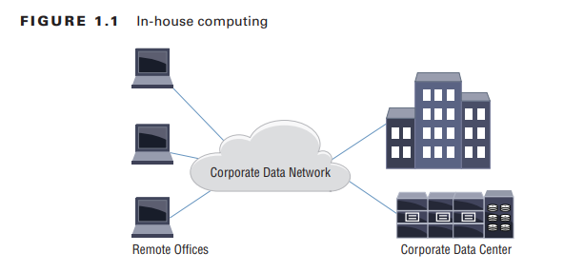
What is cloud computing?

Slide 8
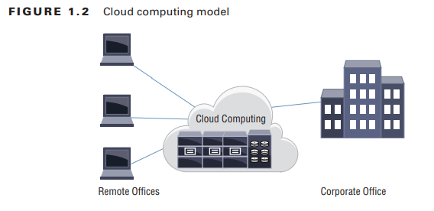
What is cloud computing?

Slide 9
What is cloud computing
Cloud computing is essentially outsourcing data center operations, applications, or a section of operations to a provider of computing resources often called a cloud company or cloud service provider.
The consumer of the cloud services pays either monthly or by the amount of service used.

Slide 10
What is cloud computing?
NIST defines cloud computing as follows:
…a model for enabling convenient,
on-demand network access to a shared pool of configurable computing resources (e.g., networks, servers, storage, applications, and services)
that can be rapidly provisioned and released with minimal management effort or service provider interaction.
This cloud model is composed of five essential characteristics, three service models, and four deployment models.

Slide 11
NIST five characteristics of cloud computing
Five basic characteristics (National Institute of Standards and Technology's (NIST)defines):
on-demand self-service,
broad network access,
resource pooling,
rapid elasticity or expansion,
measured service
Note: https://nvlpubs.nist.gov/nistpubs/Legacy/SP/nistspecialpublication800-145.pdf

Slide 12
NIST five characteristics of cloud computing
On-demand self-service. (self-provisioning)
A consumer can unilaterally provision computing capabilities, such as server time and network storage, as needed automatically without requiring human interaction with each service provider.

Slide 13
NIST five characteristics of cloud computing
Broad network access.
Capabilities are available over the network and accessed through standard mechanisms that promote use by heterogeneous thin or thick client platforms (e.g., mobile phones, tablets, laptops, and workstations).

Slide 14
NIST five characteristics of cloud computing
Resource pooling.
The provider’s computing resources are pooled to serve multiple consumers using a multi-tenant model, with different physical and virtual resources dynamically assigned and reassigned according to consumer demand.
There is a sense of location independence in that the customer generally has no control or knowledge over the exact location of the provided resources but may be able to specify location at a higher level of abstraction (e.g., country, state, or datacenter).
Examples of resources include storage, processing, memory, and network bandwidth.

Slide 15
NIST five characteristics of cloud computing
Rapid elasticity. (automatic provisioning and de-provisioning)
Capabilities can be elastically provisioned and released, in some cases automatically, to scale rapidly outward and inward commensurate with demand. To the consumer, the capabilities available for provisioning often appear to be unlimited and can be appropriated in any quantity at any time

Slide 16
NIST five characteristics of cloud computing
Measured service. (utility computing)
Cloud systems automatically control and optimize resource use by leveraging a metering capability at some level of abstraction appropriate to the type of service (e.g., storage, processing, bandwidth, and active user accounts).
Resource usage can be monitored, controlled, and reported, providing transparency for both the provider and consumer of the utilized service.

Slide 17
So why cloud computing??
There are many advantages to moving to the cloud, but three stand out as compelling business and operations alternatives to hosting computing resources internally in a privately owned data center.
Computing as service and Fast deployment,
No or less up-front cost/pay-as-you-go
Elasticity

Slide 18
So why cloud computing??
In the past when computing resources were initially needed, there was often a long delay of
procuring,
installing,
and configuring all of the pieces needed to host an application.
With a cloud solution,
the equipment is already running in a cloud provider’s data center, you can rent this computing resources as service on-demand
often as short as a few minutes.

Slide 19
So why cloud computing??
From a financial perspective, a company’s expenditures can be reduced as
cloud computing avoids the large up-front costs of purchasing the needed computing equipment
and ongoing support expenses associated with maintaining your own computing environment.
Cloud computing,
with its pay-as-you-go billing model, you will pay based on utility or based on duration of use (days, months..)

Slide 20
So why cloud computing??
Elasticity: As capacity is reached, a cloud computing model can expand almost immediately
as compared to a corporate data center, where long delays are often experienced because of the need to procure, install, and configure the new equipment.

Slide 21
So why cloud computing??
In-house computing requires a data center full of the needed computing gear to support the company’s operations.
Engineers are needed to tend to the operating systems, applications, storage, and networks.
Computing resource goes underutilization and not sufficient frequently, as computing resources are fixed.

Slide 22
Evolution (computing to cloud computing)
Decades of process/evolution
Mainframe computer
-> client-server (centralized)
->distributed (decentralized)
->virtualization
->grid-based
-> utility computing
->cloud computing

Slide 23
Emergence of Cloud Computing
The origin of the term cloud computing is obscure, but it appears to derive from the practice of using drawings of stylized clouds to denote networks in diagrams of computing and communications systems. The word cloud is used as a metaphor for the Internet, based on the standardized use of a cloud-like shape to denote a network on telephony schematics and later to depict the Internet in computer network diagrams as an abstraction of the underlying infrastructure it represents. The cloud symbol was used to represent the Internet as early as 1994.

Slide 24
Emergence of Cloud Computing
In the 1990s, telecommunications companies, who previously offered primarily dedicated point-to-point data circuits, began offering virtual private network (VPN) services with comparable quality of service but at a much lower cost. By switching traffic to balance utilization as they saw fit, they were able to utilize their overall network bandwidth more effectively. The cloud symbol was used to denote the demarcation point between that which was the responsibility of the provider and that which was the responsibility of the users. Cloud computing extends this boundary to cover servers as well as the network infrastructure.

Slide 25
Emergence of Cloud Computing
The underlying concept of cloud computing dates back to the 1950s; when large- scale mainframe became available in academia and corporations, accessible via thin clients /terminal computers.
Because it was costly to buy a mainframe, it became important to find ways to get the greatest return on the investment in them, allowing multiple users to share both the physical access to the computer from multiple terminals as well as to share the CPU time, eliminating periods of inactivity, which became known in the industry as time-sharing.

Slide 26
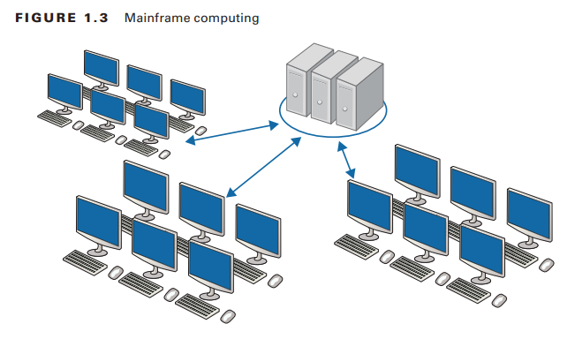
Emergence of Cloud Computing

Slide 27
Emergence of Cloud Computing
As in the earliest stages, the term “cloud” was used to represent the computing space between the provider and the end user. In 1997, Professor Ramnath Chellapa of Emory University and the University of South California defined cloud computing as the new “computing paradigm where the boundaries of computing will be determined by economic rationale rather than technical limits alone.” This has become the basis of what we refer to today when we discuss the concept of cloud computing.

Slide 28
Emergence of Cloud Computing
Some people think cloud computing is the next big thing in the world of IT. Others believe it is just another variation of the utility computing model that has been repackaged in this decade as something new and cool.

Slide 29
Emergence of Cloud Computing
One of the first milestones for cloud computing was the arrival of Salesforce.com in 1999, which pioneered the concept of delivering enterprise applications via a simple website. The services firm paved the way for both specialist and mainstream software firms to deliver applications over the internet.

Slide 30
Emergence of Cloud Computing
The next development was Amazon Web Services in 2002, which provided a suite of cloud-based services including storage, computation and even human intelligence through the Amazon Mechanical Turk. Then in 2006, Amazon launched its Elastic Compute cloud (EC2) as a commercial web service that allows small companies and individuals to rent computers on which to run their own computer applications.

Slide 31
Cloud-based service models
Cloud service models are characterized by the term as a service
and are accessed by many types of devices, including web browsers, thin clients, and mobile devices.
There are three primary (core) service types:
Software as a Service (SaaS),
Platform as a Service (PaaS)
Infrastructure as a Service (IaaS),

Slide 32
Cloud-based service models
Cloud providers use more descriptive terms in their marketing and sales offerings, as:
Communications as a Service (CaaS),
Anything as a Service (XaaS),
Desktop as a Service (DaaS),
Business Process as a Service (BPaaS)

Slide 33
Software as a Service (SaaS)
NIST offers standard definitions of SaaS as:
The capability provided to the consumer is to use the provider’s applications running on a cloud infrastructure. Example: Google Docs
The applications are accessible from various client devices through a thin client interface such as a Web browser (e.g., Web-based e-mail), or a program interface.
The consumer does not manage or control the underlying cloud infrastructure including network, servers, operating systems, storage, or even individual application capabilities, with the possible exception of limited user specific application configuration settings

Slide 34
Software as a Service (SaaS)
Good examples:
customer relationship management,
enterprise resource planning,
human resources,
payroll,
and software development applications.

Slide 35
Software as a Service (SaaS)
Good examples:
customer relationship management,
enterprise resource planning,
human resources,
payroll,
and software development applications.

Slide 36
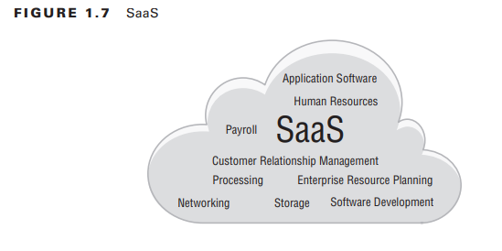
Software as a Service (SaaS)

Slide 37
Infrastructure as a Service (IaaS)
Infrastructure as a Service is described by NIST as follows:
The capability provided to the consumer is to provision processing, storage, networks, and other fundamental computing resources
In these resources the consumer is able to deploy and run arbitrary software, which can include operating systems and applications.

Slide 38
Infrastructure as a Service (IaaS)
The consumer does not manage or control the underlying cloud infrastructure
but has control over operating systems, storage, deployed applications; and possibly limited control of select networking components (e.g., host firewalls).
most flexibility of any of the e-service models
The cloud consumer rent a basic computing hardware platform and can build their solutions on top of that.

Slide 39
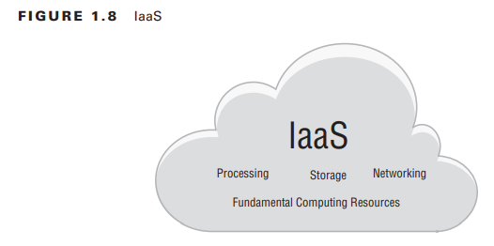
Infrastructure as a Service (IaaS)

Slide 40
Platform as a Service (PaaS)
NIST definition:
The capability provided to the consumer is to deploy onto the cloud infrastructure consumer-created or -acquired applications created using programming languages and tools supported by the provider.

Slide 41
Platform as a Service (PaaS)
The consumer does not manage or control the underlying cloud infrastructure including network, servers, operating systems, or storage, but has control over the deployed applications and possibly application hosting environment configurations.
Platform as a Service offers the compute and operating systems as a service and allows customers to install their applications on the cloud platform.

Slide 42
Platform as a Service (PaaS)
cloud provider takes responsibility up to the operating system level, including all hardware and OS software.
The consumer can deploy their applications quickly without having to purchase and install their own servers and associated equipment.
This allows for the rapid deployment of applications.

Slide 43
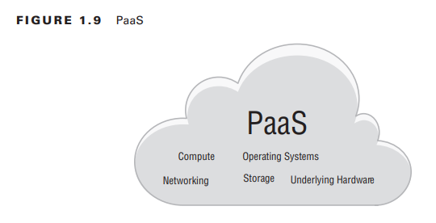
Platform as a Service (PaaS)

Slide 44
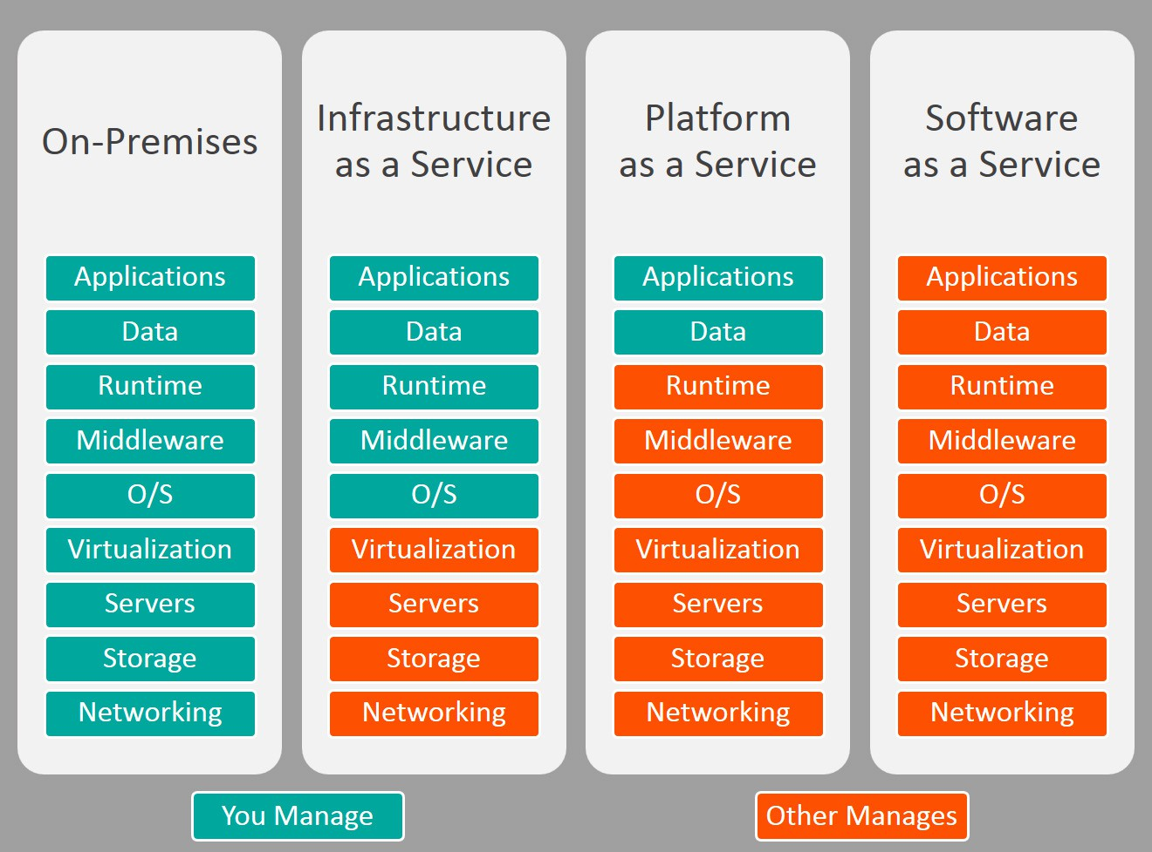

Slide 45
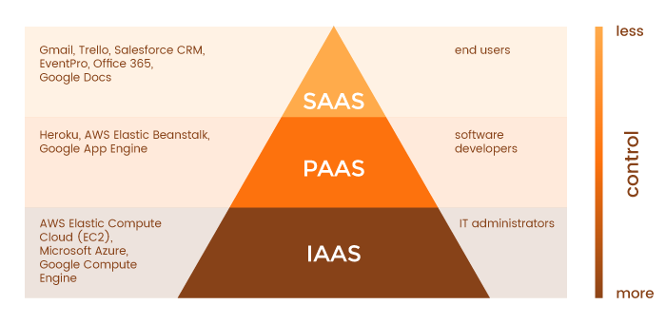

Slide 46
Communications as a Service
Communications as a Service includes hosted voice, video conferencing, instant messaging, e-mail, collaboration, and all other communication services that are hosted in the cloud.
These outsourced corporate communication services can support on-premise or mobile users accessing the applications hosted in the cloud.
The service allows even small to medium-sized businesses to implement advanced technologies at a reasonable metered cost.

Slide 47
Anything as a Service
Anything as a Service (XaaS) could best be described as offering complete IT services as a package.
Anything as a Service is the combination of the services described in this section.
It is a broad term that is a catchall of the various service offerings.

Slide 48
Monitoring as a Service (MaaS)
Monitoring as a Service (MaaS) is a security service that provides security to IT assets of any business 24/7. It plays a vital role in securing an enterprise or government clients from any possible cyber threats. MaaS is a monitoring service that can be outsourced in a flexible and consumption-based subscription model.
MaaS lets early detection of threats and reports it to their customer via emails.

Slide 49
Introducing Cloud Components
The cloud can be viewed as any other modern data center with the primary differentiator being that:
cloud deployments make heavy use of on-demand self-service provisioning,
broad network access,
resource pooling,
rapid elasticity,
virtualization,
and a measured or pay-as-you-go pricing model.

Slide 50
Introducing Cloud Components
Applications
Automation
Computing
Networking
Security
Storage
Virtualization

Slide 51
Introducing Cloud Components
Application:
user applications, including databases, web servers, e-mail, big data, and other common business software applications.

Slide 52
Introducing Cloud Components
Automation:
Automation software systems operate in a cloud provider’s data center that automates the deployment and monitoring of cloud offerings.
Everything from network, storage, and compute can be virtualized and automated.
This makes rapid deployment possible and enables users to have control over their cloud usage.

Slide 53
Introducing Cloud Components
Computing:
The compute resources are the actual central processing of data and applications on either a physical or virtualized server running a variety of operating systems.

Slide 54
Introducing Cloud Components
Networking
Network cloud services include traditional switching and routing as well as services such as load balancing, DNS, DHCP, and virtual private networks.

Slide 55
Introducing Cloud Components
Security:
Just as security is a critical component in private and corporate data centers, so is it in the cloud.
Cloud service providers offer many security services including firewalls, access control, intrusion detection and prevention systems, and encryption services.

Slide 56
Introducing Cloud Components
Storage:
Large storage arrays and storage area networks exist in the cloud for use by cloud service consumers.
Common storage media are solid-state drives (SSDs) and magnetic physical drives.
Storage systems include object, block, and file-based systems.
Some storage is optimized for high availability and durability, and others are less expensive and offer long-term, or archival, storage.

Slide 57
Introducing Cloud Components
Virtualization:
Virtualization is the ability to take physical data center resources such as RAM, CPU, storage, and networking and create a software representation of those resources in large-scale cloud offerings.
These virtualized resources are consumed by a hypervisor for allocation to virtualized computers, or virtual machines as they are commonly called, for the dynamic elasticity of modern cloud offerings.

Slide 58
Introducing Cloud Components
Connecting the Cloud to the Outside World:
Ubiquitous access refers to the ability to access cloud resources from anywhere in the network from a variety of devices such as laptops, tables, smart-phones, and thin or thick clients.
Access can be over a corporate network sitting behind a firewall or public over the Internet.

Slide 59
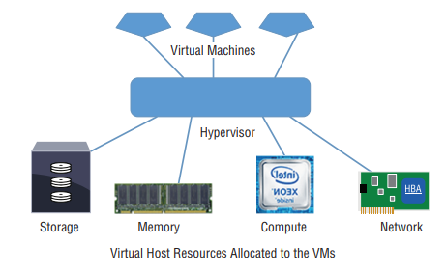

Slide 60
Cloud: Delivery Models
These models help to differentiate between cloud offerings in the marketplace.
By understanding the types of models, you can get the big-picture overview of the overall scope of cloud computing.
These are the four primary cloud delivery models.
■ Public
■ Private
■ Community
■ Hybrid

Slide 61
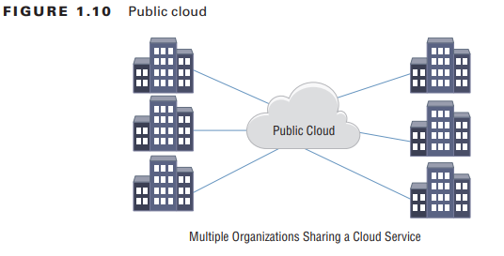
Cloud: Delivery Models
Public cloud: most common delivery model deployed
The public cloud is defined as infrastructure designed for use by public consumers.
This is the utility-based pay-as-you-go service where
the customer uses external, or public, compute resources.

Slide 62
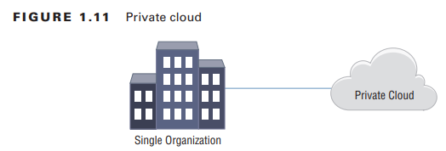
Cloud: Delivery Models
Private cloud:
A private cloud can be thought of as the traditional corporate data center with a new name applied to it to keep up with modern times.
It is for the exclusive use of a single organization but may be used by many units or entities inside a company.

Slide 63
Cloud: Delivery Models
Community clouds
Community clouds are offered for a specific community of interest and shared by companies with similar requirements for regulatory compliance, security, or policy.
Examples may be community cloud sites deployed for medical, financial, or e-commerce sites that all share common use case architectures.

Slide 64
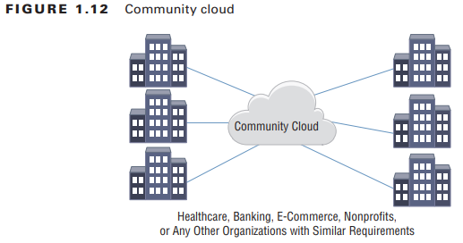
Cloud: Delivery Models

Slide 65
Cloud: Delivery Models
Hybrid cloud:
delivery models where many clouds are interconnected by companies to meet their requirements.
For example, a corporation may use a public cloud to augment its internal or private cloud operations.
A dentist’s office may use the public cloud for its compute requirements and also connect to a community cloud shared by other dentists to access a specific dental application.

Slide 66
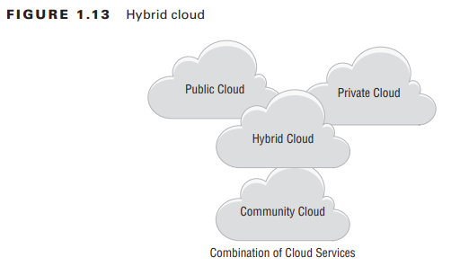
Cloud: Delivery Models

